Slide 1

CSE-400 Fundamentals of Probability in Computing
Milestone - 4
Section -1
Group: s1_g13_net

Slide 2

Project Context and Motivation
Application: IEEE 802.11 Wireless LAN
Problem: Multiple nodes → collisions → reduced throughput
Baseline: Binary Exponential Backoff Algorithm (BEBA)
Key Issue: Network behavior is inherently random
Goal: Improve performance using controlled randomization
“Instead of fighting randomness, we leverage it to improve system performance.”

Slide 3
Deterministic Baseline Overview
BEBA Mechanism:
Backoff ∼ Uniform(0, CW−1)
Collision → CW doubles
Success → CW resets
What we already did:
Monte Carlo simulation (50,000 slots)
Metrics:
Throughput
Collision rate
Channel utilization
Limitations:
Same rule for all nodes → synchronization
High collisions at scale
No adaptability
Deterministic rules = predictable → leads to repeated collisions

Slide 4
Project System Pipeline Overview
System Pipeline:
1. Nodes generate packets
2. Nodes select random backoff
3. Backoff counter decreases each slot
4. Transmission attempt when counter = 0
5. Channel outcome: Idle / Success / Collision
Performance metrics measured from simulation
Decision rule = Backoff + CW update stage

Slide 5
Sources of Uncertainty in the Project
Random backoff values
Random number of active nodes
Random collisions
Slot-level randomness
Even baseline system is probabilistic → deterministic control is insufficient

Slide 6
Random Variables in the System
r: Backoff counter
τ: Transmission probability
N: Number of nodes
Bk​: Number of transmitting nodes
Channel Probabilities:
Pidle=(1−τ)^N
Psuccess=Nτ(1−τ)N−1​
Pcollision=1−Pidle−Psuccess ​

Slide 7
Gap in Baseline
Why Deterministic BEBA Falls Short
Nodes behave similarly → synchronized transmissions
Leads to:
Collision bursts
Throughput degradation
Static CW update → ignores network state
Deterministic rules amplify collisions under congestion”

Slide 8
Algorithm Flow/LOGIC
Node attempts transmission
Observe outcome
Apply probabilistic rule:
Random number ∈ [0,1]
Decide CW update
Select new backoff
Continue simulation
Integrated into existing Python Monte Carlo simulation

Slide 9
Randomized Algorithm Design
Key Idea:
Introduce randomness in backoff selection to avoid synchronized transmissions
Use uniform random distribution for backoff values
After Collision:
CW = min(2 × CW, CWmax)
backoff ∼ Uniform(0, CW − 1)
After Success:
CW = CWmin
backoff ∼ Uniform(0, CWmin − 1)
Key Advantage:
Desynchronizes node transmissions
Reduces repeated collisions
Improves throughput and channel utilization
Implementation:
Implemented using Python random number generator
Applied at every transmission decision

Slide 10
Probabilistic Reasoning
​
Why Randomization Works
Breaks Synchronization
Randomization reduces node synchronization and spreads transmission attempts over time
Reduces Simultaneity
Lowers probability of simultaneous transmissions causing collisions
Controls Patterns
Introduces controlled randomness to break persistent collision patterns
Reduces Pcollision
Improves Psuccess

Slide 11
Implementation of Randomized Strategy
Integration Framework
Modified existing Python simulation with randomized logic
Backoff Selection
Replaced uniform distribution with probabilistic adjustment
CW Update Rules
Implemented adaptive window sizing with random parameters
Monte Carlo Simulation
Multiple runs to characterize probabilistic behavior

Slide 12
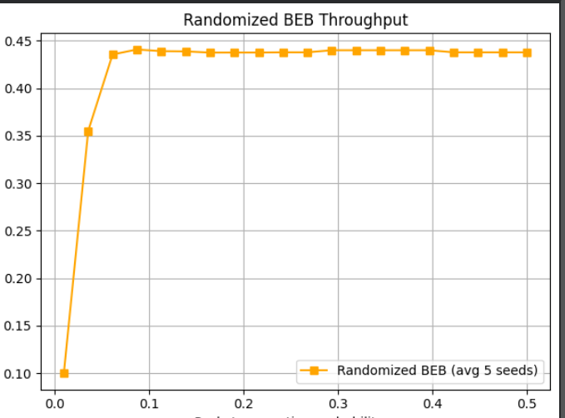
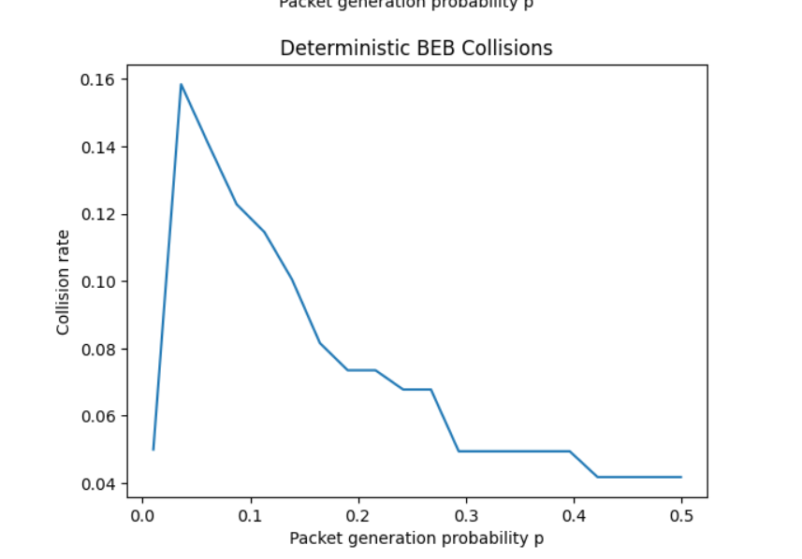
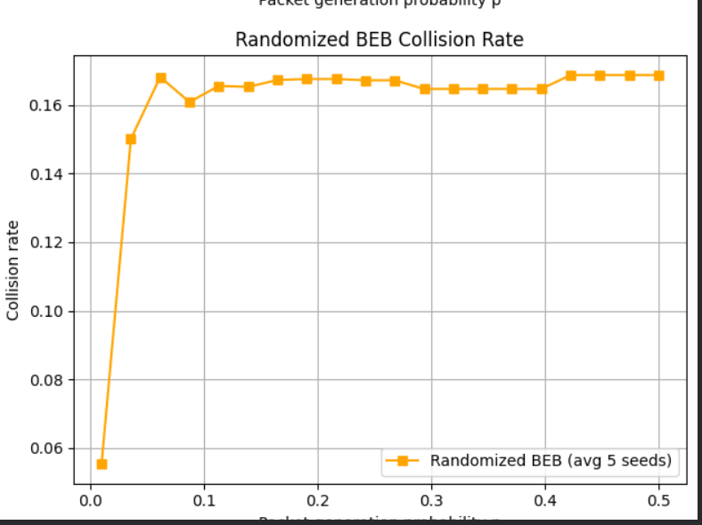
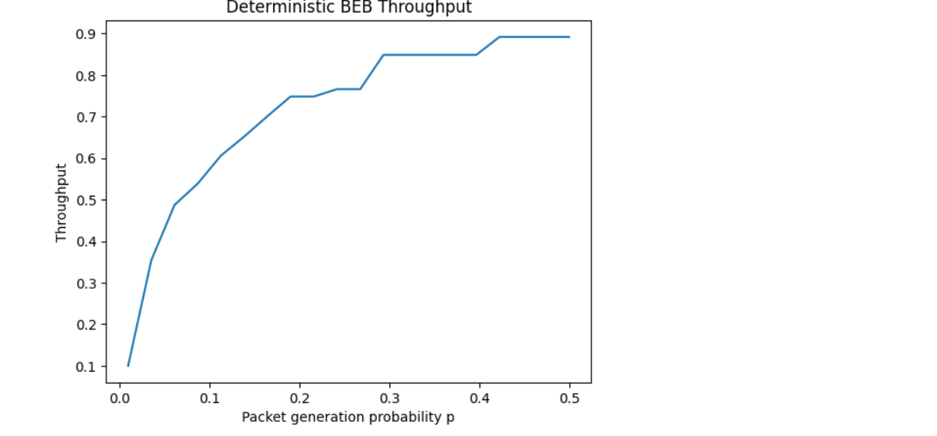
Simulation Results
Expected Results
Randomized BEBA should show:
Lower collision rates
Better throughput at high load
More stable performance
Key Metrics
Throughput → System efficiency
Collision probability → Network stability
Channel utilization → Effectiveness

Slide 13
Key Insights
“Randomization transforms worst-case behavior into stable average-case performance.”
Randomization improves load balancing
Avoids repeated collision patterns
More robust under congestion
Small randomness → big performance gain

Slide 14
Current Limitations
Model Limitations
- Ideal channel assumption (no noise or interference) - Hidden terminal problem not modeled - Fixed number of nodes used in simulation
Simulation Limitations
- Simplified traffic generation model - Limited network size considered

Slide 15
Conclusion
Deterministic BEBA has limitations
Randomized strategy improves system behavior
Probability theory helps design better algorithms
Simulation validates improvements

